Slide 1
Azure RBAC

Slide 2
Azure Authorization
Azure Active Directory admin roles
Azure RBAC roles
Classic subscription admin roles
Azure account Admin

Slide 3
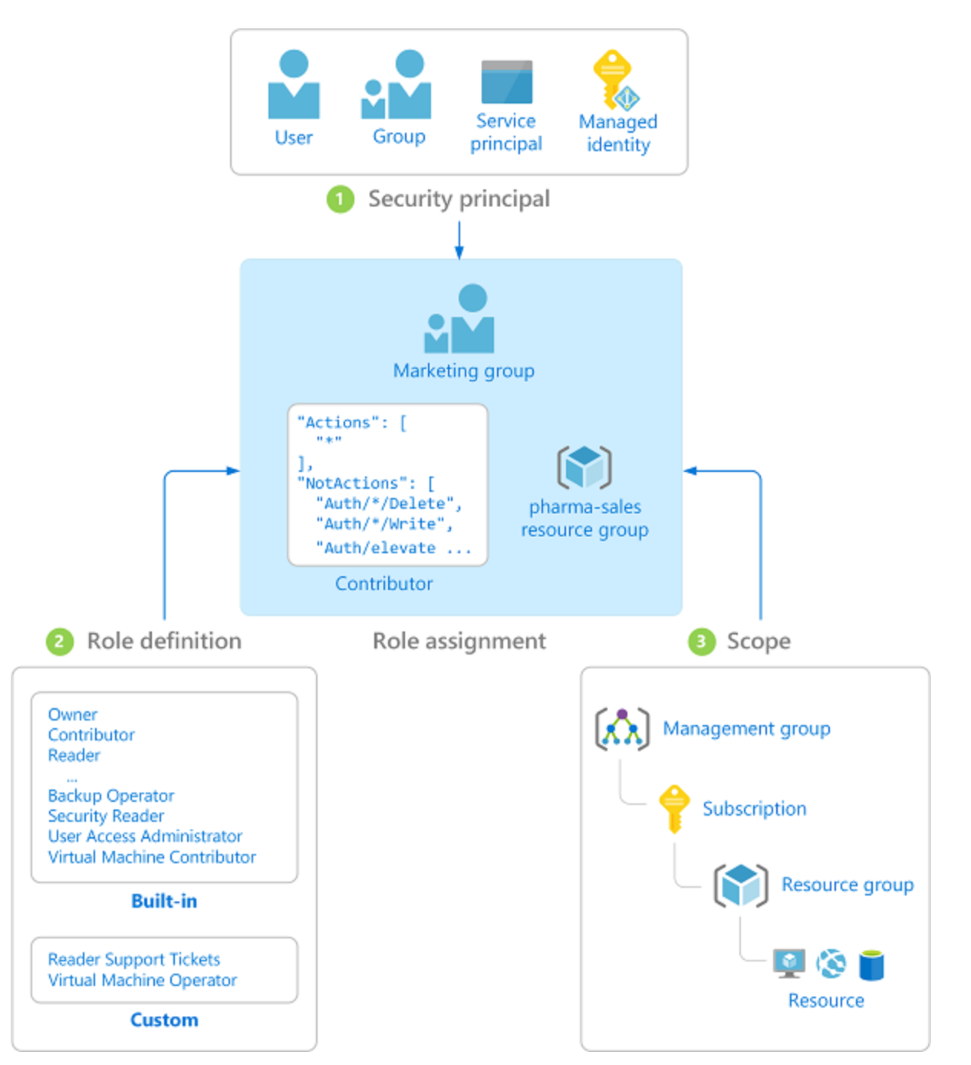
Azure RBAC Components
Security Principal
User, group, service principal, managed identity
Role Definition
Collection of permissions (Actions, NotActions, DataActions, NotDataActions, AssignableScopes)
Scope
Set of resources the access applies to
Management Groups, Subscriptions, Resource Group, Resources
Role Assignment
Process of attaching role definition to a security principal

Slide 4
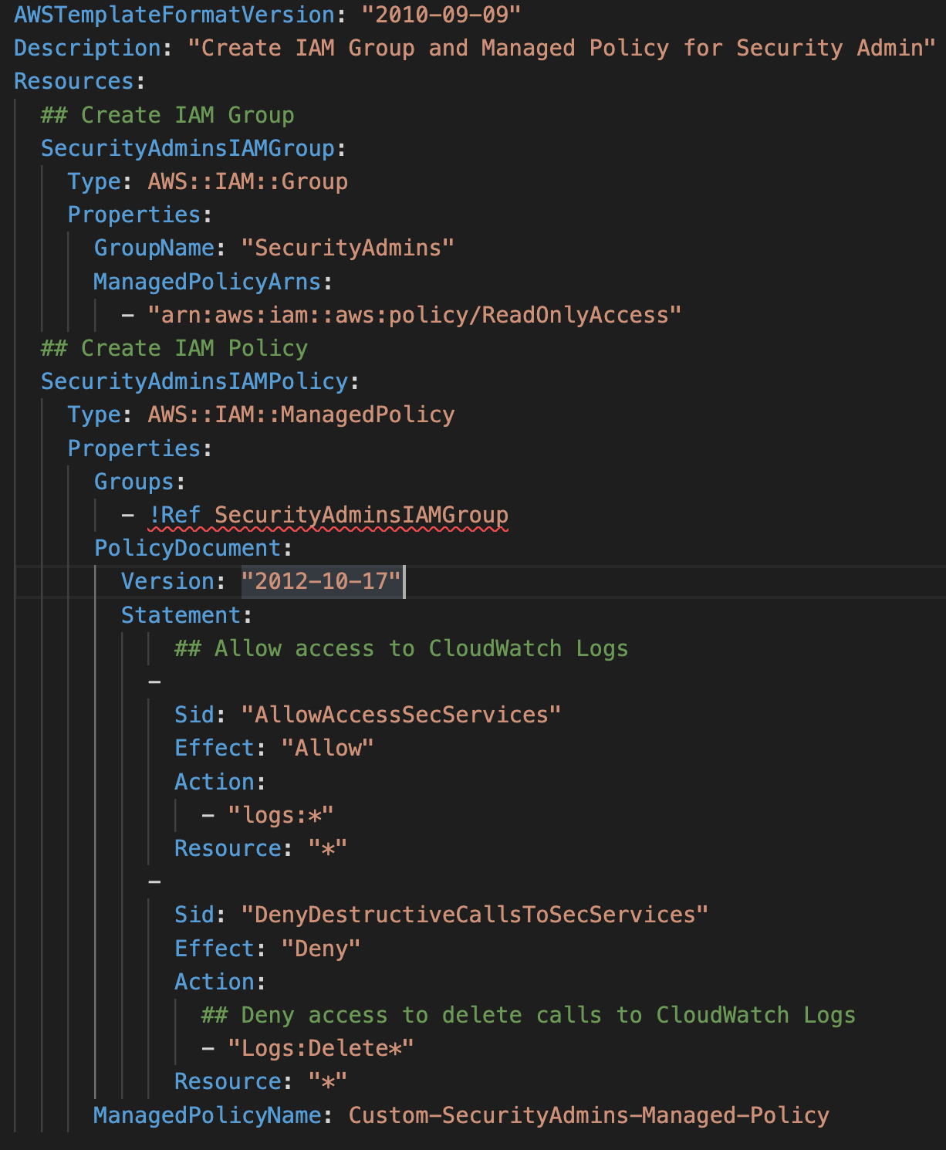
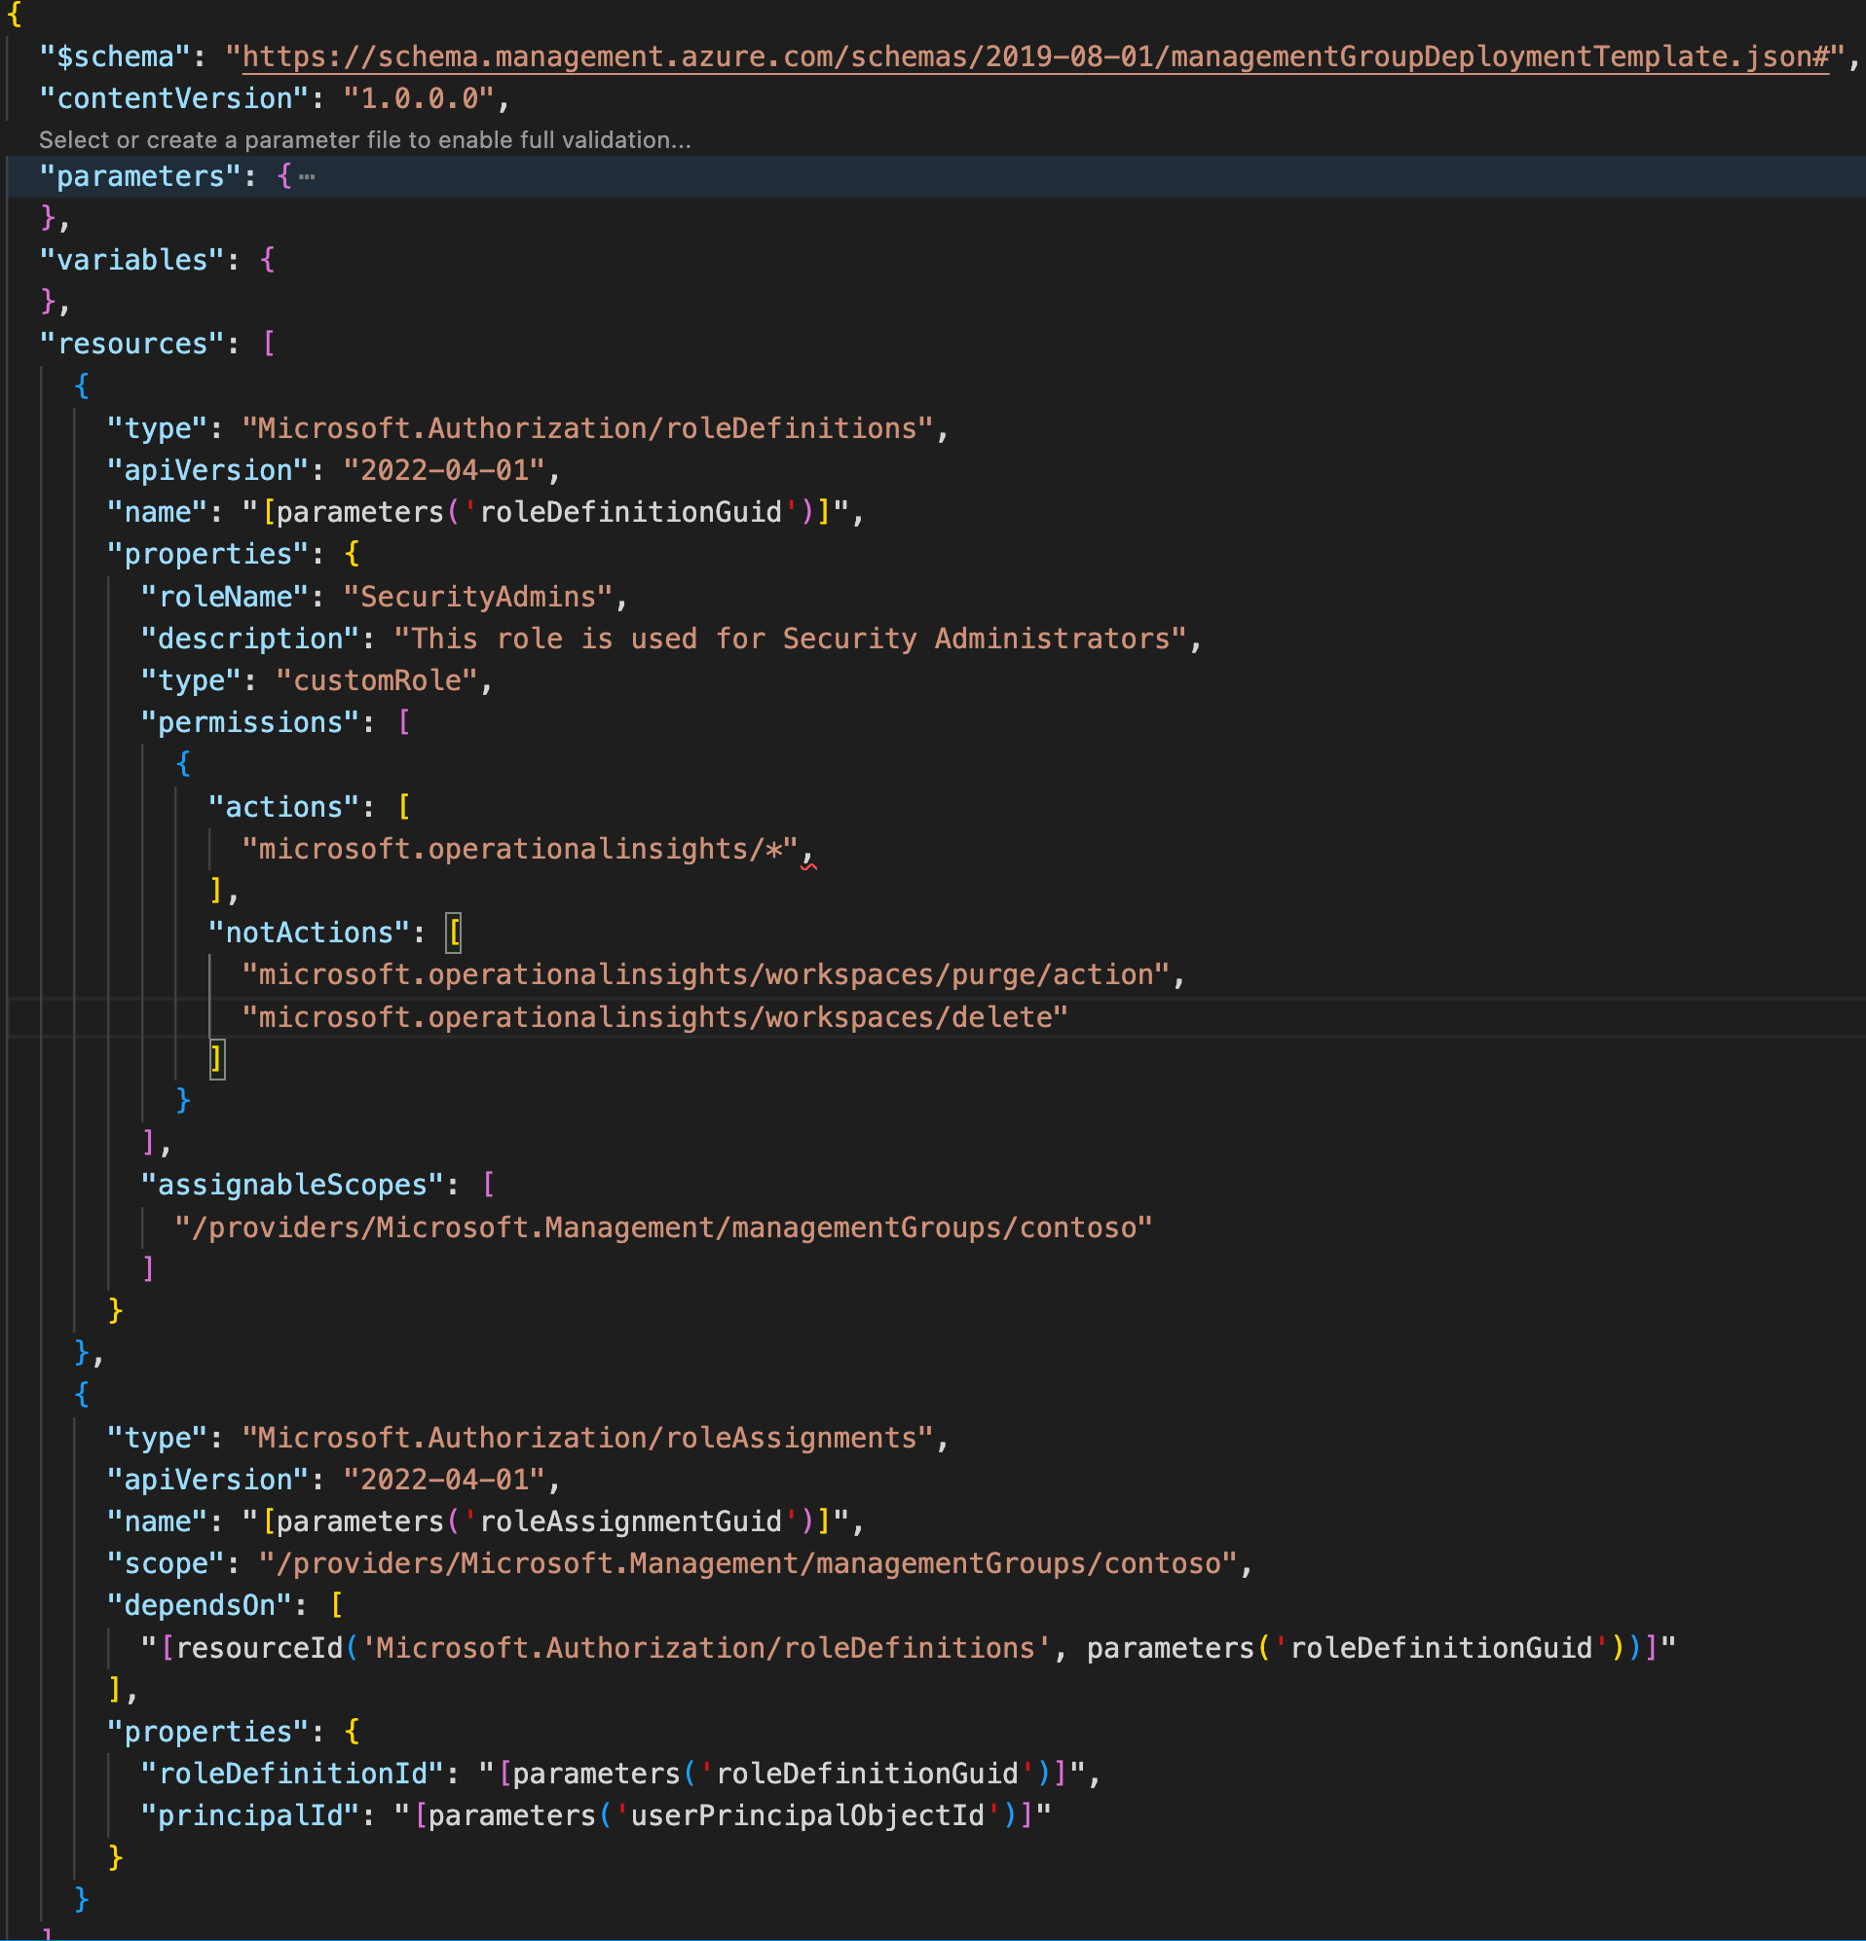
AWS IAM Policy vs Azure RBAC Role Definition
Notes:
Note that NotActions simply remove permissions from the granted permissions. It is not a Deny and the security principal could be granted the permission via another role.

Slide 5
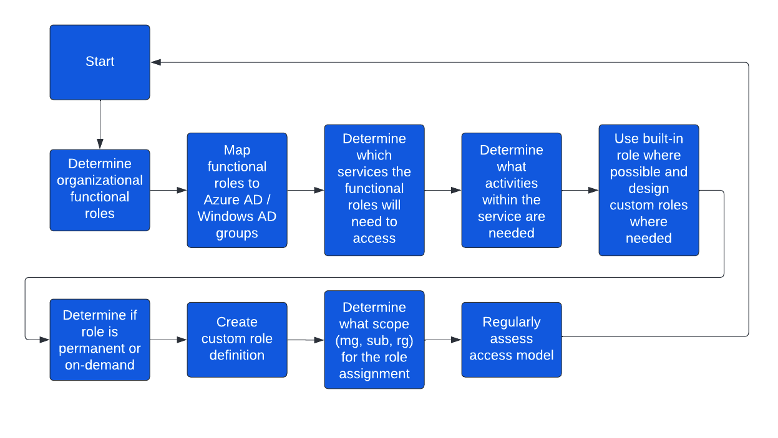
Path to RBAC Design

Slide 6
RACI Workshop
1-to-2-day Microsoft-funded workshop
Assist organizations with understanding and establish ownership for key processes for the governance and operationalization of Azure
Identifies decision makers and key stakeholders required for Azure adoption helping to accelerate decision making and adoption
Helpful artifact for the customer to use when developing an Azure RBAC authorization model

Slide 7
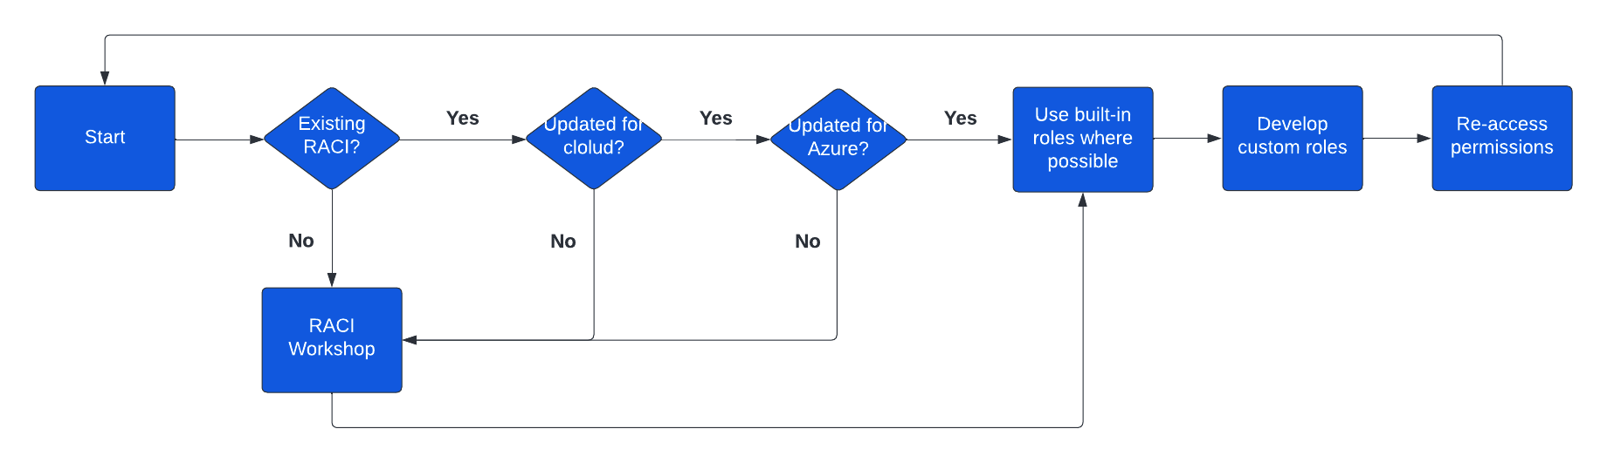
RACI Workshop Decision
You will likely benefit from this workshop regardless of your Azure maturity

Slide 8
Azure RBAC - Design Recommendations
Before designing your Azure RBAC roles, establish a RACI matrix which tasks each team within the organization will be performing in Azure.
Follow the principal of least privilege and separation of duty when designing Azure RBAC roles.
Leverage Just-In-Time concepts for granting privileged roles which can include Azure AD Privileged Identity Management or a third-party PAM/PSM.
Start with built-in role definitions and customize as you better understand which tasks your teams will be performing in Azure.
Create RBAC Role definitions and assignments at the management group level whenever possible.
Notes:
Note that creating custom role definitions and assignments at the Management Group level is currently in Public Preview (As of 1/23/23)
DataActions are not supported in the preview for definitions or assignments at the Management Group level (there is a separate private preview for this functionality)

